Slide 1
Distributed Systems
By
Mr. Celestin MBONABUCYA
Email: cmbonabucya@ur.ac.rw

Slide 2
1 Introduction
Distributed Systems - what and why
Architecture (Hardware and Software)
Challenges
Overview - Principles and Paradigms
Course Details

Slide 3
Introduction Cont…
Examples of distributed systems
Collection of Web servers: distributed database of hypertext and multimedia documents
Distributed file system on a LAN
Domain Name Service (DNS)
Cray XT6 & CLE (massive multiprocessor)

Slide 4
Introduction (Cont…)
What is a distributed system?
Andrew Tannenbaum defines it as follows:
A distributed system is a collection of independent
computers that appear to its users as a single coherent
system.
Is there any such system? Hardly———–! Kind of
We will learn about the challenges in building “true” distributed
systems
For the time being, we go by a weaker definition of
distributed system:
A distributed system is a collection of independent
computers that are used jointly to perform a single
task or to provide a single service.

Slide 5
Introduction Cont….
Find more examples of distributed systems:
Remember
A distributed system is a collection of independent
computers that are used jointly to perform a single
task or to provide a single service.
What’s the difference between a distributed application and distributed system?

Slide 6
THE ADVANTAGES OF DISTRIBUTED SYSTEMS
What are economic and technical reasons for having distributed systems?
Cost. Better price/performance as long as commodity hardware is used for the component computers
Performance. By using the combined processing and storage capacity of many nodes, performance levels can be reached that are out of the scope of centralized machines
Scalability. Resources such as processing and storage capacity can be increased incrementally
Reliability. By having redundant components, the impact of hardware and software faults on users can be reduced
Inherent distribution. Some applications like the Web are naturally distributed

Slide 7
THE ADVANTAGES OF DISTRIBUTED SYSTEMS (Cont…)
What problems are there in the use and development of distributed systems?
New component: network. Networks are needed to connect independent nodes, are subject to performance limits, and constitute another potential point of failure
Security. It is easier to compromise distributed systems
Software complexity. Distributed software is more complex and harder to develop than conventional software; hence, it is more expensive and harder to get right
Distributed systems are hard to build and understand
➔ this course is going to be very challenging!

Slide 8
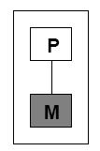
HARDWARE ARCHITECTURE
Uniprocessor:
Properties:
Single processor
Direct memory access

Slide 9
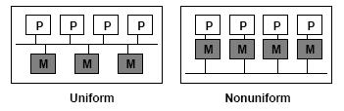
HARDWARE ARCHTECTURE
Multiprocessor:
Properties:
Multiple processors
Direct memory access
Uniform memory access (e.g., SMP, multicore)
Nonuniform memory access (e.g., NUMA)

Slide 10
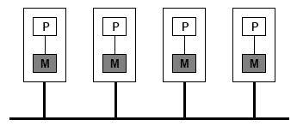
Multicomputers
Properties:
Multiple computers
No direct memory access
Network
Homogeneous vs. Heterogeneous

Slide 11
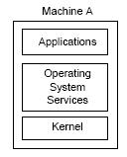
SOFTWARE ARCHITECTURE
Uniprocessor OS:

Slide 12
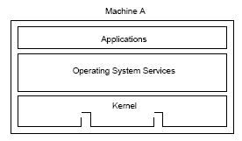
Multiprocessor OS:
Similar to a uniprocessor OS but:
Kernel designed to handle multiple CPUs
Number of CPUs is transparent
Communication uses same primitives as uniprocessor OS
Single system image

Slide 13
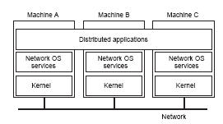
Network OS:
Properties:
No single system image
Individual nodes are highly autonomous
All distribution of tasks is explicit to the user
Examples: Linux, Windows

Slide 14
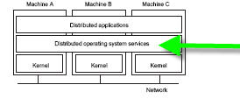
Distributed OS
Properties:
High degree of transparency
Single system image (FS, process, devices, etc.)
Homogeneous hardware
Examples: Amoeba, Plan 9, Chorus, Mungi
Are there any problems with this approach?

Slide 15
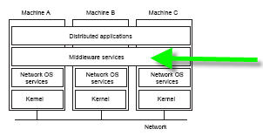
Middleware:
Properties:
System independent interface for distributed programming
Improves transparency (e.g., hides heterogeneity)
Provides services (e.g., naming service, transactions, etc.)
Provides programming model (e.g., distributed objects)

Slide 16
Why is Middleware ’Winning’?:
Builds on commonly available abstractions of network Oses (processes and message passing)
Examples: RPC, NFS, CORBA, DCOM, J2EE, .NET (Assignment #1Q1)
Also languages (or language modifications) specially designed for distributed computing
Examples: Erlang, Ada, Limbo, etc. (Assignment #1Q2)
➔Usually runs in user space
➔Raises level of abstraction for programming ü less error-prone
➔ Independence from OS, network protocol, programming language, etc. ➔ Flexibility

Slide 17
DISTRIBUTED SYSTEMS AND PARALLEL COMPUTING
Parallel computing: improve performance by using multiple processors per application
There are two flavors:
1. Shared-memory systems:
• Multiprocessor (multiple processors share a single bus and memory unit)
• SMP (Symmetric MultiProcessing) support in OS
• Much simpler than distributed systems
• Limited scalability
2. Distributed memory systems:
• Multicomputer (multiple nodes connected via a network)
• These are a form of distributed systems
• Share many of the challenges discussed here
• Better scalability & cheaper

Slide 18
DISTRIBUTED SYSTEMS IN CONTEXT
Networking:
Network protocols, routing protocols, etc.
Distributed Systems: make use of networks
Operating Systems:
Resource management for single systems
Distributed Systems: management of distributed resources
In This Course:
Generalized solutions to distributed systems problems and challenges
Infrastructure software to help build distributed applications

Slide 19
BASIC PROBLEMS AND CHALLENGES IN DISTRIBUTED SYSTEMS
The distributed nature of a systems gives rise to the following challenges:
Transparency
Scalability
Dependability
Performance
Flexibility
This course will examine approaches and techniques for
designing and building distributed systems that address these challenges.

Slide 20
TRANSPARENCY
Concealment of the separation of the components of a distributed system (single image view).
There are a number of forms of transparency
Access: Local and remote resources accessed in same way
Location: Users unaware of location of resources
Migration: Resources can migrate without name change
Replication: Users unaware of existence of multiple copies
Failure: Users unaware of the failure of individual components
Concurrency: Users unaware of sharing resources with others
Is transparency always desirable? Is it always possible?

Slide 21
SCALABILITY
A system is said to be scalable if it can handle the addition of users and resources without suffering a noticeable loss of performance or increase in administrative complexity
[B. Clifford Neuman]
Scale has three dimensions:
Size: number of users and resources (problem: overloading)
Geography: distance between users and resources (problem: communication)
Administration: number of organizations that exert administrative control over parts of the system (problem: administrative mess)
Note:
Scalability often conflicts with (small system) performance
Claim of scalability is often abused

Slide 22
Techniques for scaling:
Decentralization
Hiding communication latencies (asynchronous communication, reduce communication)
Distribution (spreading data and control around)
Replication (making copies of data and processes)

Slide 23
Decentralization
Avoid centralizing:
Services (e.g., single server)
Data (e.g., central directories)
Algorithms (e.g., based on complete information).
With regards to algorithms:
Do not require machine to hold complete system state Why? Cfr notes
Allow nodes to make decisions based on local info Why? Cfr notes
Algorithms must survive failure of nodes
No assumption of a global clock
Decentralization is hard

Slide 24
DEPENDABILITY
Dependability of distributed systems is a double-edged sword:
➔Distributed systems promise higher availability:
– Replication
➔But availability may degrade:
– More components ➔more potential points of failure
Dependability requires consistency, security, and fault tolerance

Slide 25
PERFORMANCE
Any system should strive for maximum performance
In distributed systems, performance directly conflicts with some other desirable properties
Transparency
Security
Dependability
Scalability

Slide 26
FLEXIBILITY
Build a system out of (only) required components
Extensibility: Components/services can be changed or added
Openness of interfaces and specification
allows reimplementation and extension
Interoperability
Separation of policy and mechanism
standardized internal interfaces

Slide 27
COMMON MISTAKES
False assumptions commonly made:
Reliable network
Secure network
Everything is homogeneous
Topology does not change
Zero latency
Infinite bandwidth
Zero transport cost
One administrator

Slide 28
PRINCIPLES
Several key principles underlying the functioning of all distributed systems
System Architecture
Communication
Replication and Consistency
Synchronization
Naming
Fault Tolerance
Security
Discussion of these principles will form the core content of the course

Slide 29
PARADIGMS
Most distributed systems are built based on a particular paradigm (or model)
Shared memory
Distributed objects
Distributed file system
Distributed coordination
Shared documents
Agents
This course will cover the first four in detail.

Slide 30
Thank You !!!!!!!!! !!!!!!

